Slide 1

Advanced x86: BIOS and System Management Mode Internals SPI Flash Programming
Xeno Kovah && Corey Kallenberg
LegbaCore, LLC

Slide 2
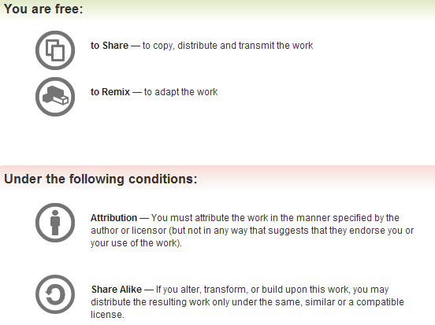
All materials are licensed under a Creative Commons “Share Alike” license.
http://creativecommons.org/licenses/by-sa/3.0/
Attribution condition: You must indicate that derivative work
"Is derived from John Butterworth & Xeno Kovah’s ’Advanced Intel x86: BIOS and SMM’ class posted at http://opensecuritytraining.info/IntroBIOS.html”
Notes:
Attribution condition: You must indicate that derivative work
"Is derived from John Butterworth & Xeno Kovah’s ’Advanced Intel x86: BIOS and SMM’ class posted at http://opensecuritytraining.info/IntroBIOS.html”

Slide 3
SPI note:
We’re not really going to care about low level SPI protocol details
We’re just going to care about the way that it’s exposed to the BIOS, so that we can understand the BIOS’s view of the world, and therefore interpret its actions accordingly

Slide 4
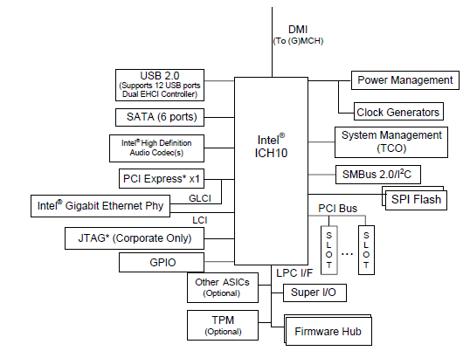
SPI (Serial Peripheral Interface) Flash
Intel provides a programmable interface to the SPI flash device
System BIOS lives here
Other stuff does too
Copernicus programs this interface to dump a binary of the SPI flash
Intel IO Controller Hub 10 Datasheet, page 31

Slide 5

How you should think of reading & writing the flash chip
All you see/need to care about
CPU
RAM
(“SPIBAR” = RCRB + X
MMIO to ICH or PCH)
Behind the scenes
ICH or PCH
Flash Chip
SPI

Slide 6


Programming the SPI Flash
You’re welcome!
RCBA holds RCRB
RCRB + X = SPIBAR
(for X = 0x3800 on all newer systems, but not old ones)
SPIBAR + Y = flash programming registers
An app can choose either “Hardware Sequencing” (meaning the hardware picks the actual SPI commands that get sent for read/write) or Software Sequencing (meaning you pick the actual SPI commands)
For simplicity of discussion, we’ll be referring to only those operations/details pertaining to Hardware Sequencing
Software Sequencing just offers a little more fine-grain control
All SPI registers in the following slides are from:
http://www.intel.com/content/www/us/en/io/io-controller-hub-10-family-datasheet.html
Bwahahaha!

Slide 7
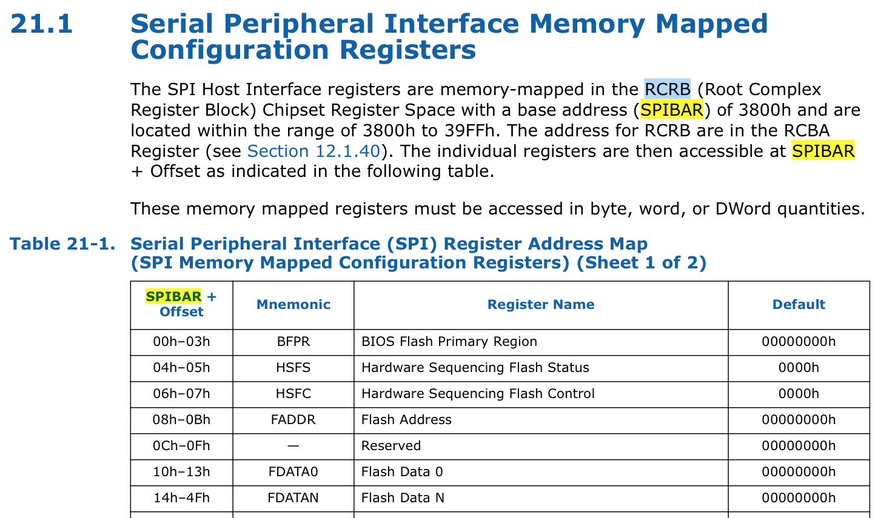
Since I didn’t have anywhere better to put this…

Slide 8

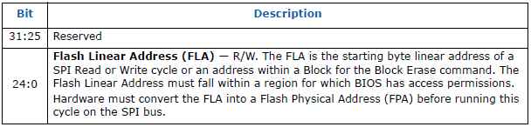
SPI Programming Flash Address Register
Specifies starting address of the SPI I/O cycle
Flash address, not a system RAM address
Valid range is 0 to <size of flash chip – 1>

Slide 9

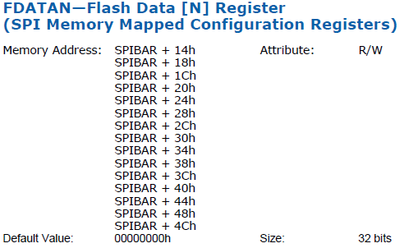
SPI Programming Data Registers
Contains the data we just read from the SPI flash (up to 64 bytes), or data we’re about to write to the flash chip
R/W (since it can be used to specify data to write to flash)
…

Slide 10

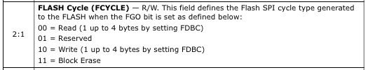
SPI Programming Control Register
Set the type to read (bits 2:1 == 00b)

Slide 11

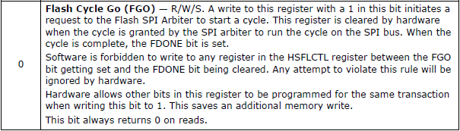
SPI Programming Control Register
Initiates the SPI I/O cycle
Used by programming app (Copernicus)
Defines the number of bits to read (or write) in the I/O cycle
Notes:
Can paste in images from ICH datasheet and circle applicable bits

Slide 12
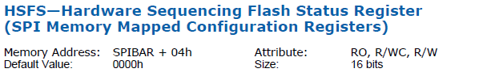
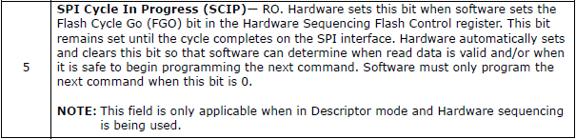
SPI Programming Status Register
Indicates that an SPI I/O cycle is in progress
Set automatically by hardware, nothing we need to really care much about
Notes:
Can paste in images from ICH datasheet and circle applicable bits

Slide 13
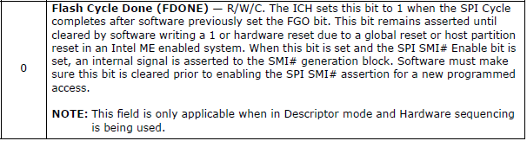
SPI Programming Status Register 2
Indicates the SPI I/O cycle has completed
Software must poll on this bit to determine when the hardware is done reading/writing data
Notes:
Can paste in images from ICH datasheet and circle applicable bits

Slide 14

Reading the flash chip
FADDR=00000…
FDATA0=00000…
FDONE=0
SCIP=0
FCYCLE=0
FGO=0
Ring 0
FADDR = 0x1000, FCYCLE=00(read)
FDBC = 111111b (64 byte read)
BIOS reading software sets up the location it wants to read (as part of reading the entire chip) and how many bytes to read

Slide 15
Reading the flash chip
FADDR=0x1000
FDATA0=00000…
FDONE=0
SCIP=0
FCYCLE=0
FGO=0
Ring 0
HSFC |= 1 (aka FGO=1)
BIOS reading software says to start the read

Slide 16
Reading the flash chip
FADDR=0x1000
FDATA0=00000…
FDONE=0
SCIP=1
FCYCLE=0
FGO=1
Ring 0
Cycle in progress
We need to poll on FDONE, waiting for it to be set to 1

Slide 17
Reading the flash chip
FADDR=0x1000
FDATA0=0xf005ba11
FDONE=1
SCIP=0
FCYCLE=0
FGO=0
Ring 0
Once the cycle is done (FDONE=1) we can do read the FDATA registers

Slide 18
Reading the flash chip
FADDR=0x1000
FDATA0=0xf005ba11
FDONE=1
SCIP=0
FCYCLE=0
FGO=0
Ring 0
Read FDATA0
0xf005ba11
BIOS reading software will get the contents out of the FDATA register(s) and store to memory and/or disk

Slide 19

Lab: RYOFC! (Read Your Own Flash Chip!)
We’re going to be cool and manually program the flash registers in RWE to read the reset vector from our flash chip
DISCLAIMER! DISCLAIMER! DISCLAIMER!
Don’t follow along unless you’re super careful! You could accidentally brick your system! :D
I am not responsible if you brick your system (or your enemies’ :P)
DISCLAIMER! DISCLAIMER! DISCLAIMER!

Slide 20

Register Access: SPI Base Address Register (SPIBAR)
SPIBAR
ICH or PCH
LPC Device | B0:D31:F0
SPIBAR
offset
Offset | Name | Value
F0h | RCBA | FED18000
RCRB
memory
SPI extends it’s Base Address Registers (BARs) to memory starting at an address called SPIBAR
SPIBAR is offset from the Root Complex Register Block (RCRB)
The offset from RCRB is chipset-dependent, but will be listed in the SPI section of the datasheet
Notes:
http://superradnow.files.wordpress.com/2012/09/spy.jpeg

Slide 21
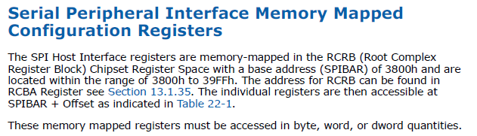
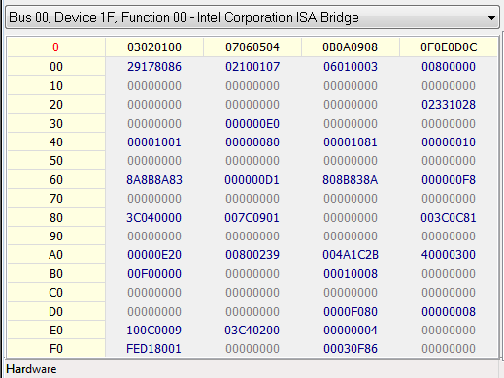
Lab: Locate SPIBAR
Per your datasheet, the SPI host interface registers (SPIBAR) is located at an offset from RCRB
In the Mobile 4-Series chipset on our lab laptop, SPIBAR is located at:
RCRB + 3800h = FED1_B800h
déjà vu!

Slide 22
Back to “Fun things to do in SMM”!

Slide 23
Attack 1 – Manipulate Copernicus output
From https://cansecwest.com/slides/2014/Copernicus2-SENTER_the-Dragon-CSW.pptx
From within the OS, targeted hooks into Copernicus code
From within the OS with “DDefy” [20] rootkit style hooks into file writing routines
From within the HD controller firmware [21][22][23]
From within the OS with a network packet filter driver
From within the NIC firmware [24][25]
Etc. Lots more options

Slide 24

Attack 2 – A new generic attack.
It is possible for SMM to be notified when SPI reads or writes occur
An attacker who controls the BIOS controls the setup of SMM
In this way a BIOS-infecting attacker can perform a SMM MitM attack against those who would try to read the BIOS to integrity check it
We call our SMM MitM “Smite’em, the Stealthy”
Notes:
http://www.creativeuncut.com/gallery-11/gw2-dragon-eye.html

Slide 25
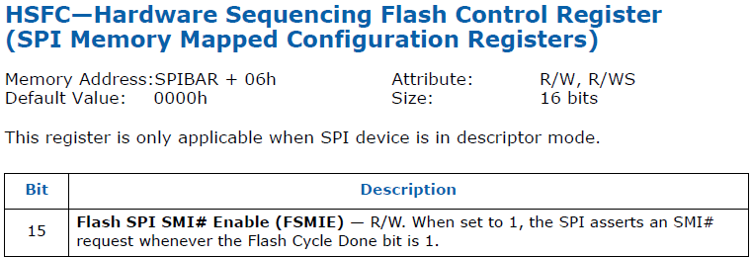
Eye of the dragon - FSMIE - hw sequencing
This is what allows an attacker in SMM to know when someone is trying to access the flash chip
The Flash Cycle Done bit is set to 1 after every read and write

Slide 26

Reading the flash chip in the presence of Smite'em
SMM
Smite'em
FADDR=00000…
FDATA0=00000…
FDONE=0
SCIP=0
FCYCLE=0
FGO=0
FSMIE=1(already set)
Ring 0
FADDR = 0x1000, FCYCLE=00(read)
FDBC = 111111b (64 byte read)
BIOS reading software sets up the location it wants to read (as part of reading the entire chip) and how many bytes to read

Slide 27
Reading the flash chip in the presence of Smite'em
SMM
Smite'em
FADDR=0x1000
FDATA0=00000…
FDONE=0
SCIP=0
FCYCLE=0
FGO=0
FSMIE=1
Ring 0
HSFC |= 1 (aka FGO=1)
BIOS reading software says to start the read

Slide 28
Reading the flash chip in the presence of Smite'em
SMM
Smite'em
FADDR=0x1000
FDATA0=00000…
FDONE=0
SCIP=1
FCYCLE=0
FGO=1
FSMIE=1
Ring 0
Cycle in progress

Slide 29
Reading the flash chip in the presence of Smite'em
SMM
Smite'em
FADDR=0x1000
FDATA0=0x1badd00d
FDONE=1
SCIP=0
FCYCLE=0
FGO=0
FSMIE=1
SMI
Ring 0
Once the cycle is done, and the data is available for reading, if the FSMIE = 1, an SMI is triggered, giving Smite'em the first look

Slide 30
Reading the flash chip in the presence of Smite'em
SMM
Smite'em
FADDR=0x1000
FDATA0=0x1badd00d
FDONE=1
SCIP=0
FCYCLE=0
FGO=0
FSMIE=1
FDATA0=0xf005ba11
Ring 0
Smite'em can change any data that would reveal its presence to the original benign data

Slide 31
Reading the flash chip in the presence of Smite'em
SMM
Smite'em
FADDR=0x1000
FDATA0=0xf005ba11
FDONE=1
SCIP=0
FCYCLE=0
FGO=0
FSMIE=1
Ring 0
Read FDATA0
0xf005ba11
BIOS reading software will be misled!

Slide 32
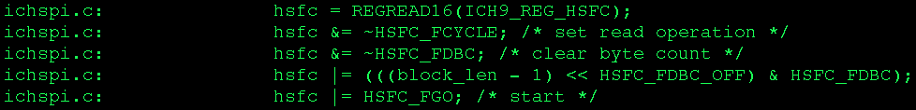
Think it can't happen?
Flashrom 0.9.7 source
If you don't account for hw/sw sequencing's FSMIE bit (as no previous software did), you will just lose and provide false assurances of a lack of BIOS compromise

Slide 33
What you don't know can bite you
The basic solution would seem to be just for querying tools to set FSMIE = 0 before trying to read
Multiple ways for an adversary to counter
Kernel agent continuously setting FSMIE = 1
So you just clear it and check if it's getting re-set, and if so…?
VMX interception of MMIO to SPI space, falsifying that you successfully cleared FSMIE
But then if they're using VMX too, they can also just directly forge FDATA
Target your security software specifically
If your tool is good enough to detect attacker, he's incentivized to go after you specifically

Slide 34
Terror at 35,000 feet (high level overview) Another attack…
Let's assume that Smite'em wants to pick another generic, low-effort way to avoid detection (i.e. doesn't want to use VMX until absolutely necessary)
Smite'em recruits a Dragon Knight avatar
Could be kernel-based code or a DMA device and independent of CPU
Avatar polls SPI configuration registers to detect if an SPI cycle is in progress
Upon detecting an SPI cycle in progress, the avatar triggers an SMI
Smite’em running in SMM has exclusive access to the CPU, and can stall until the cycle completes and then replace the data read from flash before Copernicus can read it

Slide 35


Reading the flash chip in the presence of Smite'em
SMM
Smite'em
FADDR=00000…
FDATA0=00000…
FDONE=0
SCIP=0
FCYCLE=0
FGO=0
FSMIE=0
Ring 0
FADDR = 0x1000, FCYCLE=00(read)
FDBC = 111111b (64 byte read)
Copernicus sets up the location it wants to read (as part of reading the entire chip) and how many bytes to read

Slide 36
Reading the flash chip in the presence of Smite'em
SMM
Smite'em
FADDR=0x1000
FDATA0=00000…
FDONE=0
SCIP=0
FCYCLE=0
FGO=0
FSMIE=0
Ring 0
FGO=1
Then says go

Slide 37
Reading the flash chip in the presence of Smite'em
SMM
Smite'em
FADDR=0x1000
FDATA0=00000…
FDONE=0
SCIP=1
FCYCLE=0
FGO=1
FSMIE=0
Poll for SCIP=1 and once found
poll faster for FDONE=1
Ring 0
Copernicus sets up the location it wants to read (as part of reading the entire chip) and how many

Slide 38
Reading the flash chip in the presence of Smite'em
SMM
Smite'em
FADDR=0x1000
FDATA0=0x1badd00d
FDONE=1
SCIP=0
FCYCLE=0
FGO=0
FSMIE=0
SMI
Ring 0
Once it sees the data, it tries not to race with Copernicus, but instead stops itself and Copernicus by signaling Smite'em with an SMI

Slide 39
Reading the flash chip in the presence of Smite'em
SMM
Smite'em
FADDR=0x1000
FDATA0=0x1badd00d
FDONE=1
SCIP=0
FCYCLE=0
FGO=0
FSMIE=0
FDATA0=0xf005ba11
Ring 0
Smite'em then cleans up as usual
Notes:
http://th04.deviantart.net/fs71/PRE/f/2012/220/9/6/dragon_knight_by_nickhuddlestonartist-d58112b.png

Slide 40
Better luck next time?
We then implemented a basic “Copernicus 2” that used Intel TXT to try and defeat this
We care about trustworthy detection tools. It’s no good to have detection tools if your attacker can easily bypass them and give you a false sense of trust that your system is clean
But we know that we have to start somewhere
We thought it would work because the manuals implied that TXT automatically suppresses SMIs until they’re explicitly turned back on
It turned out that it does on *old* hardware, but newer hardware turns on SMIs automatically, so our TXT code is back to being vulnerable to SMM subversion until STMs are available
That’s part of why we want STMs so much
:’(
TT
Our only consolation is that Copernicus 2 *does* take OS level attackers off the table…But really if we’re trying to detect BIOS level attackers, we need to counter SMM in order for it to matter

Slide 41
Coming soon?(ever?)
“Copernicus 3” would take our existing research on “timing-based attestation” and port it into TXT-land
Unfortunately since I said that idea while I was at MITRE, even though I didn’t implement it, probably MITRE owns the idea and I can’t do it without their permission/cooperation :-/
So for today, your only option is…

Slide 42
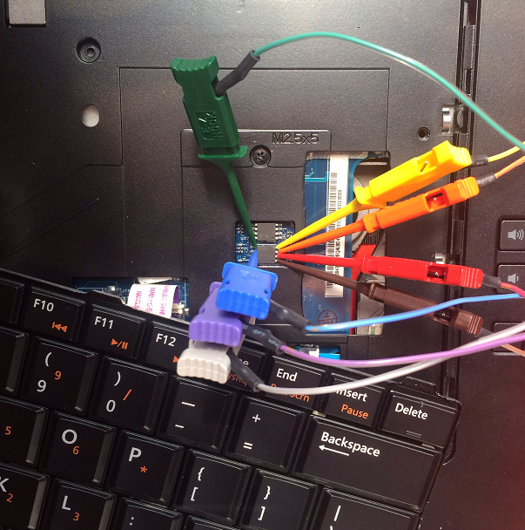
Trustworthy BIOS malware detection!
(note: doesn’t measure SMM :))
Notes:
This is the best possible case, where the BIOS is exposed for easy reflash.

